Slide 1
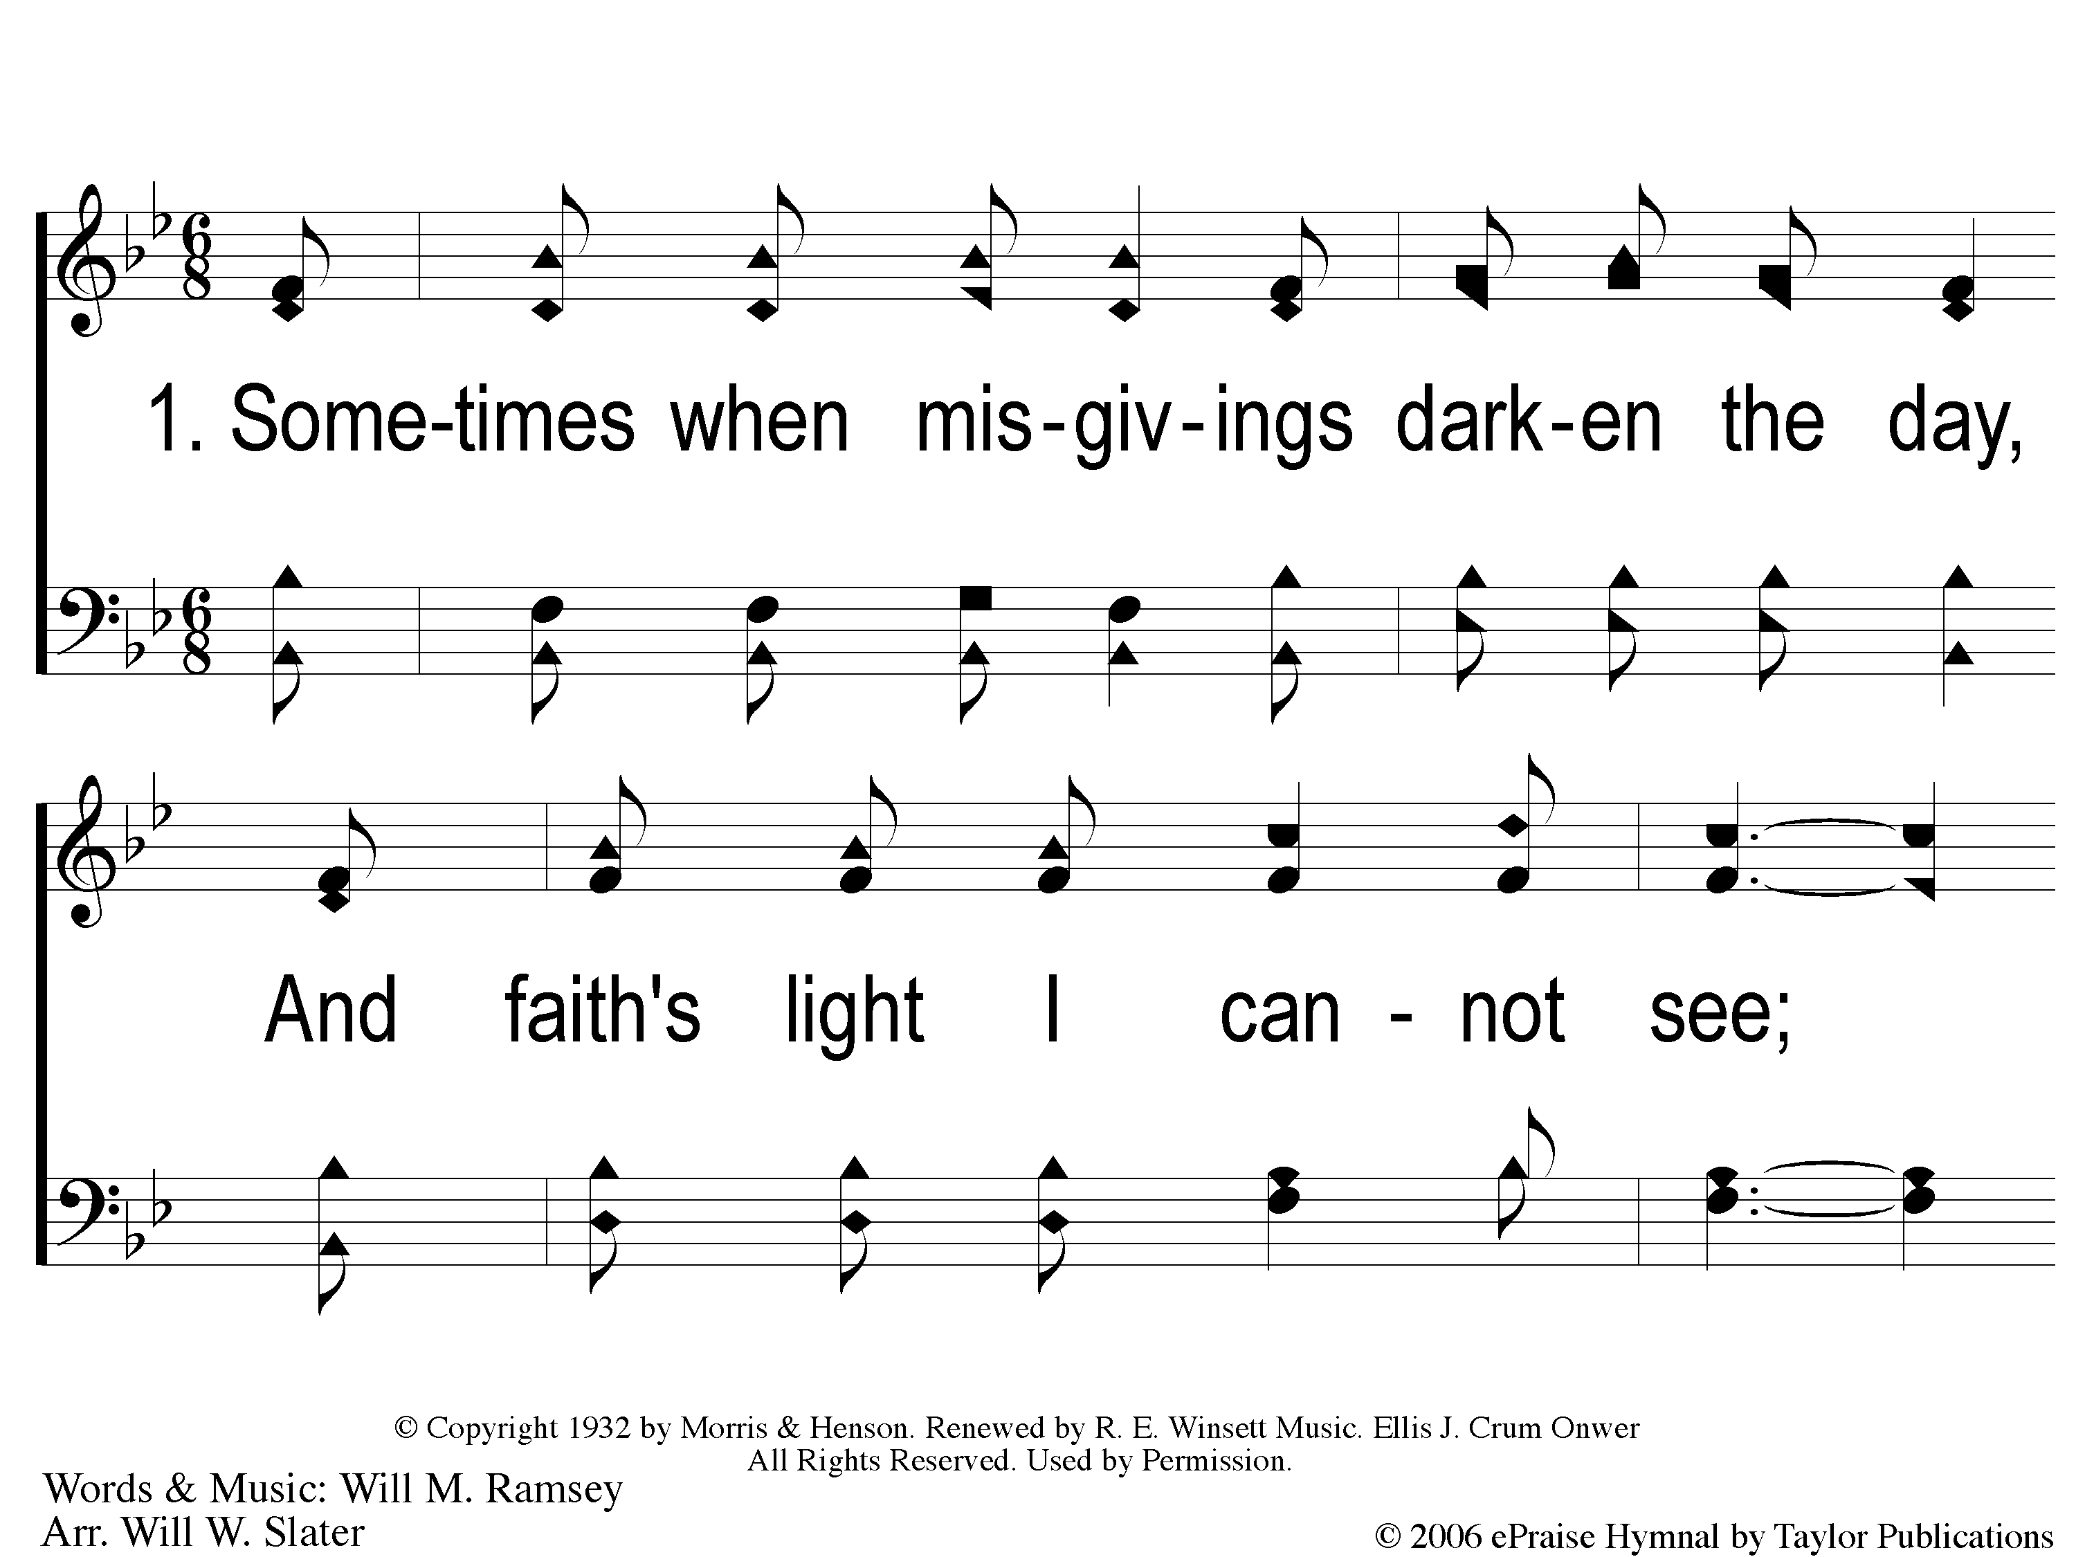
1-1 He Whispers Sweet Peace to Me
He Whispers Sweet Peace To Me
172

Slide 2
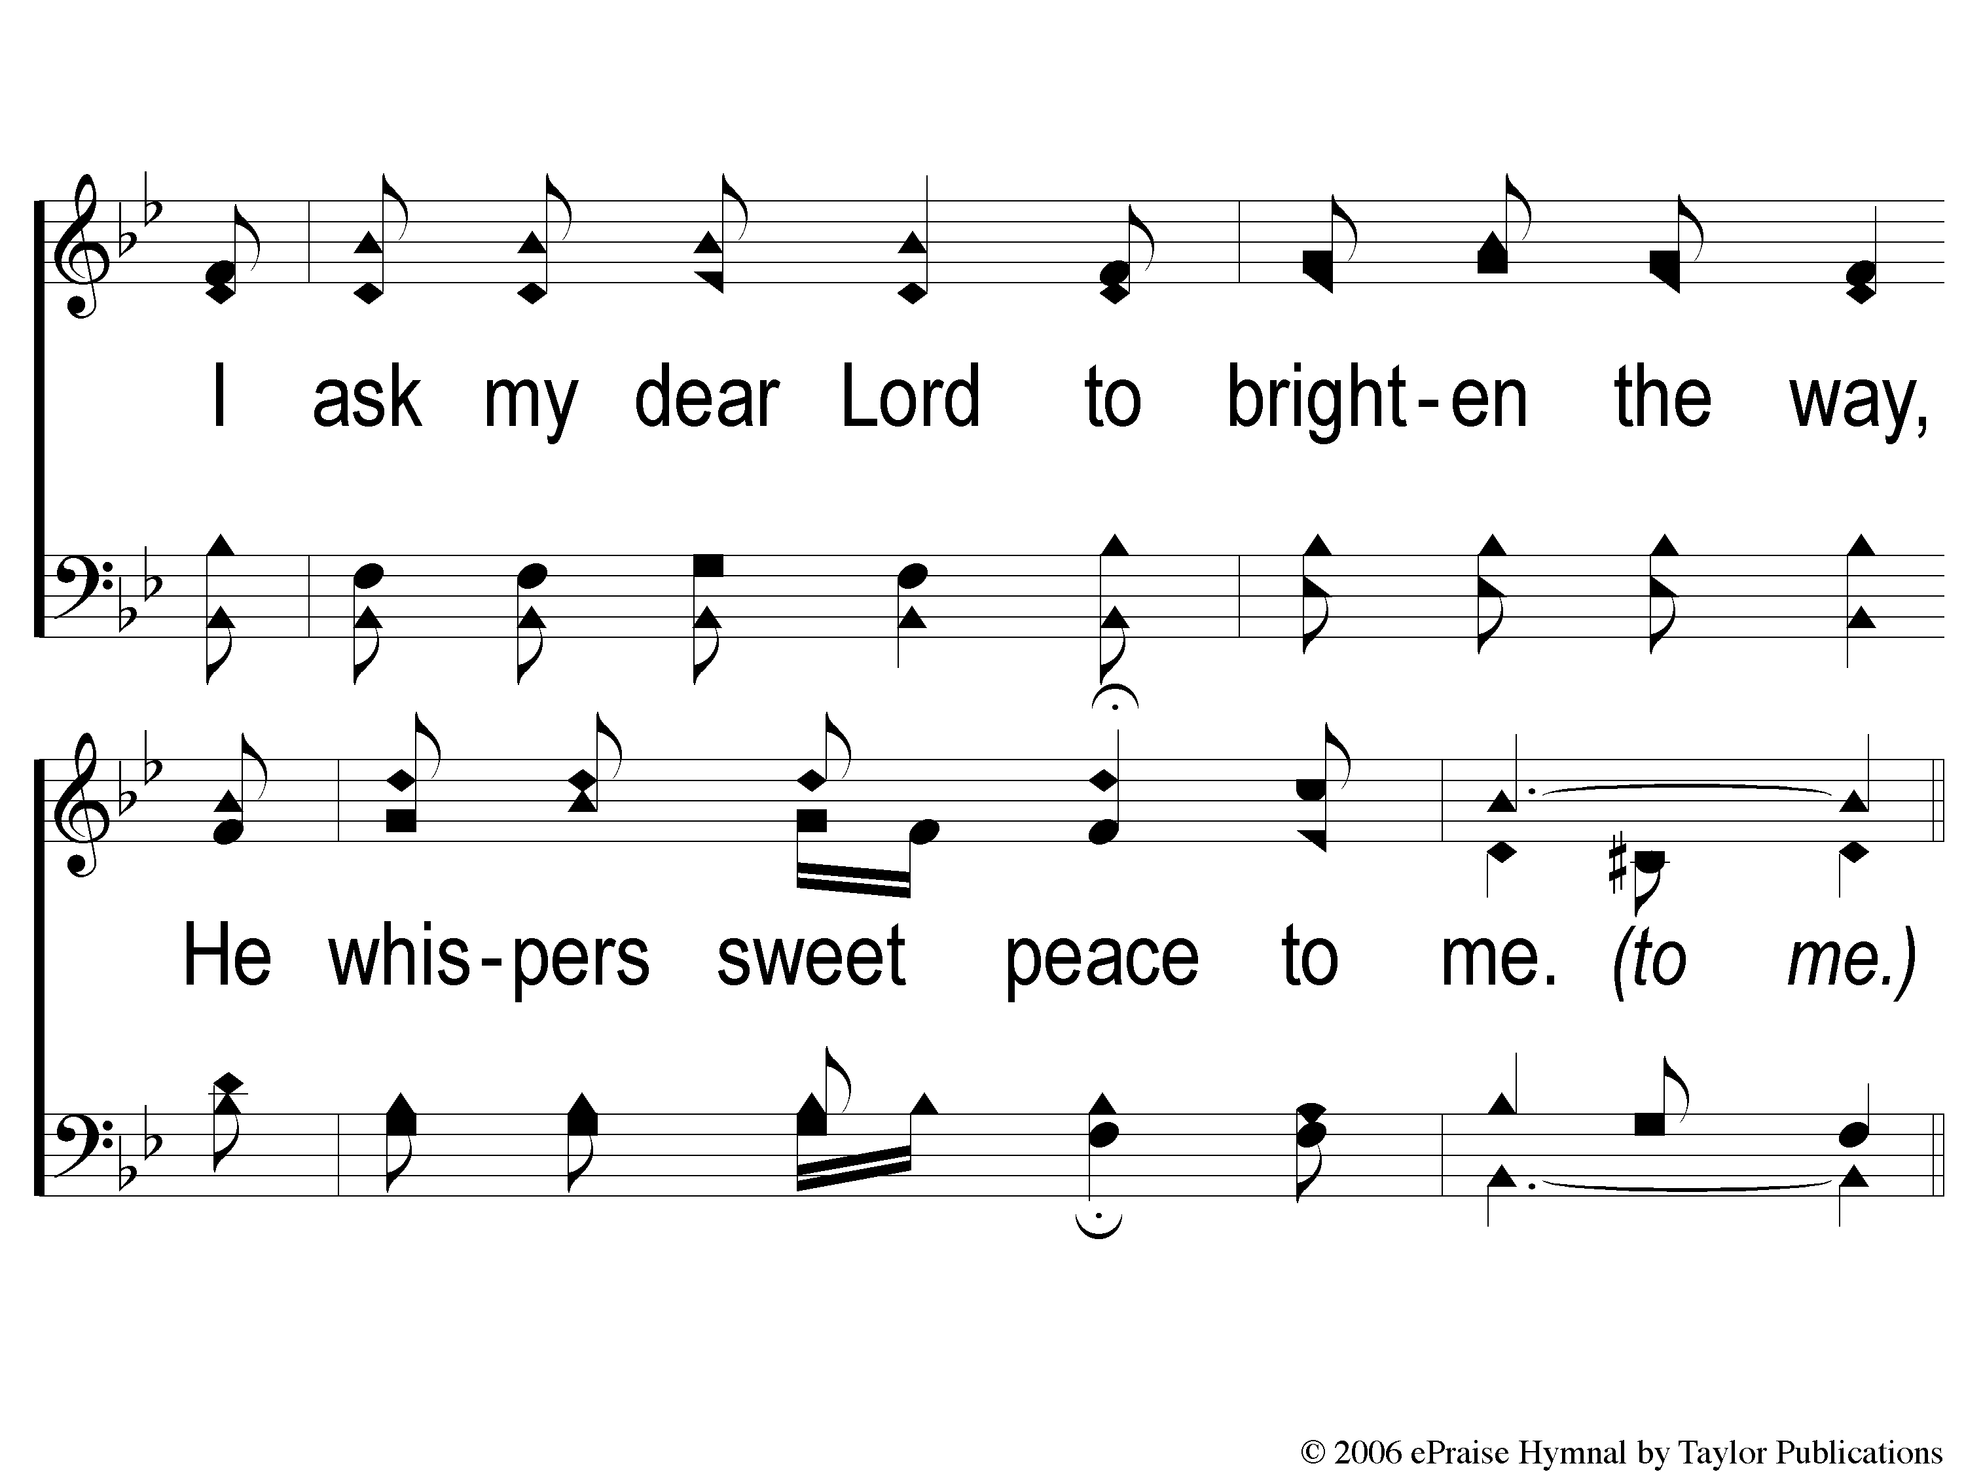
1-2 He Whispers Sweet Peace to Me
He Whispers Sweet Peace To Me
172

Slide 3
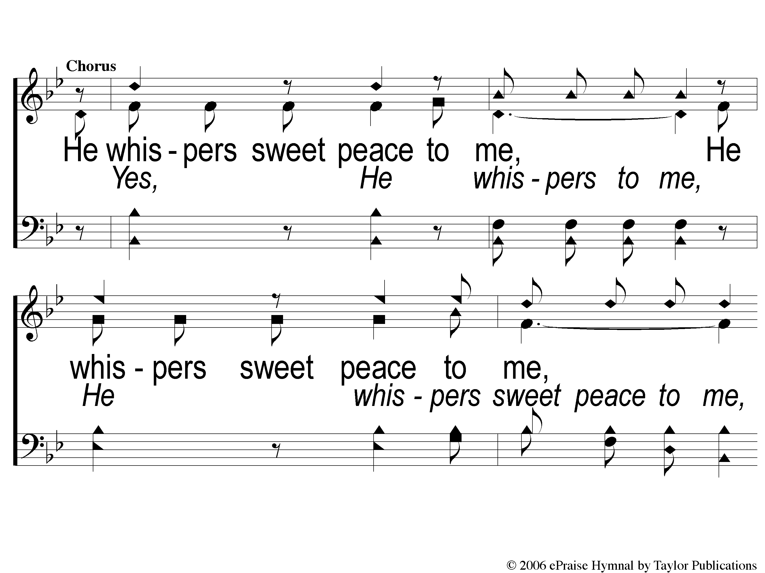
C-1 He Whispers Sweet Peace to Me
He Whispers Sweet Peace To Me
172

Slide 4
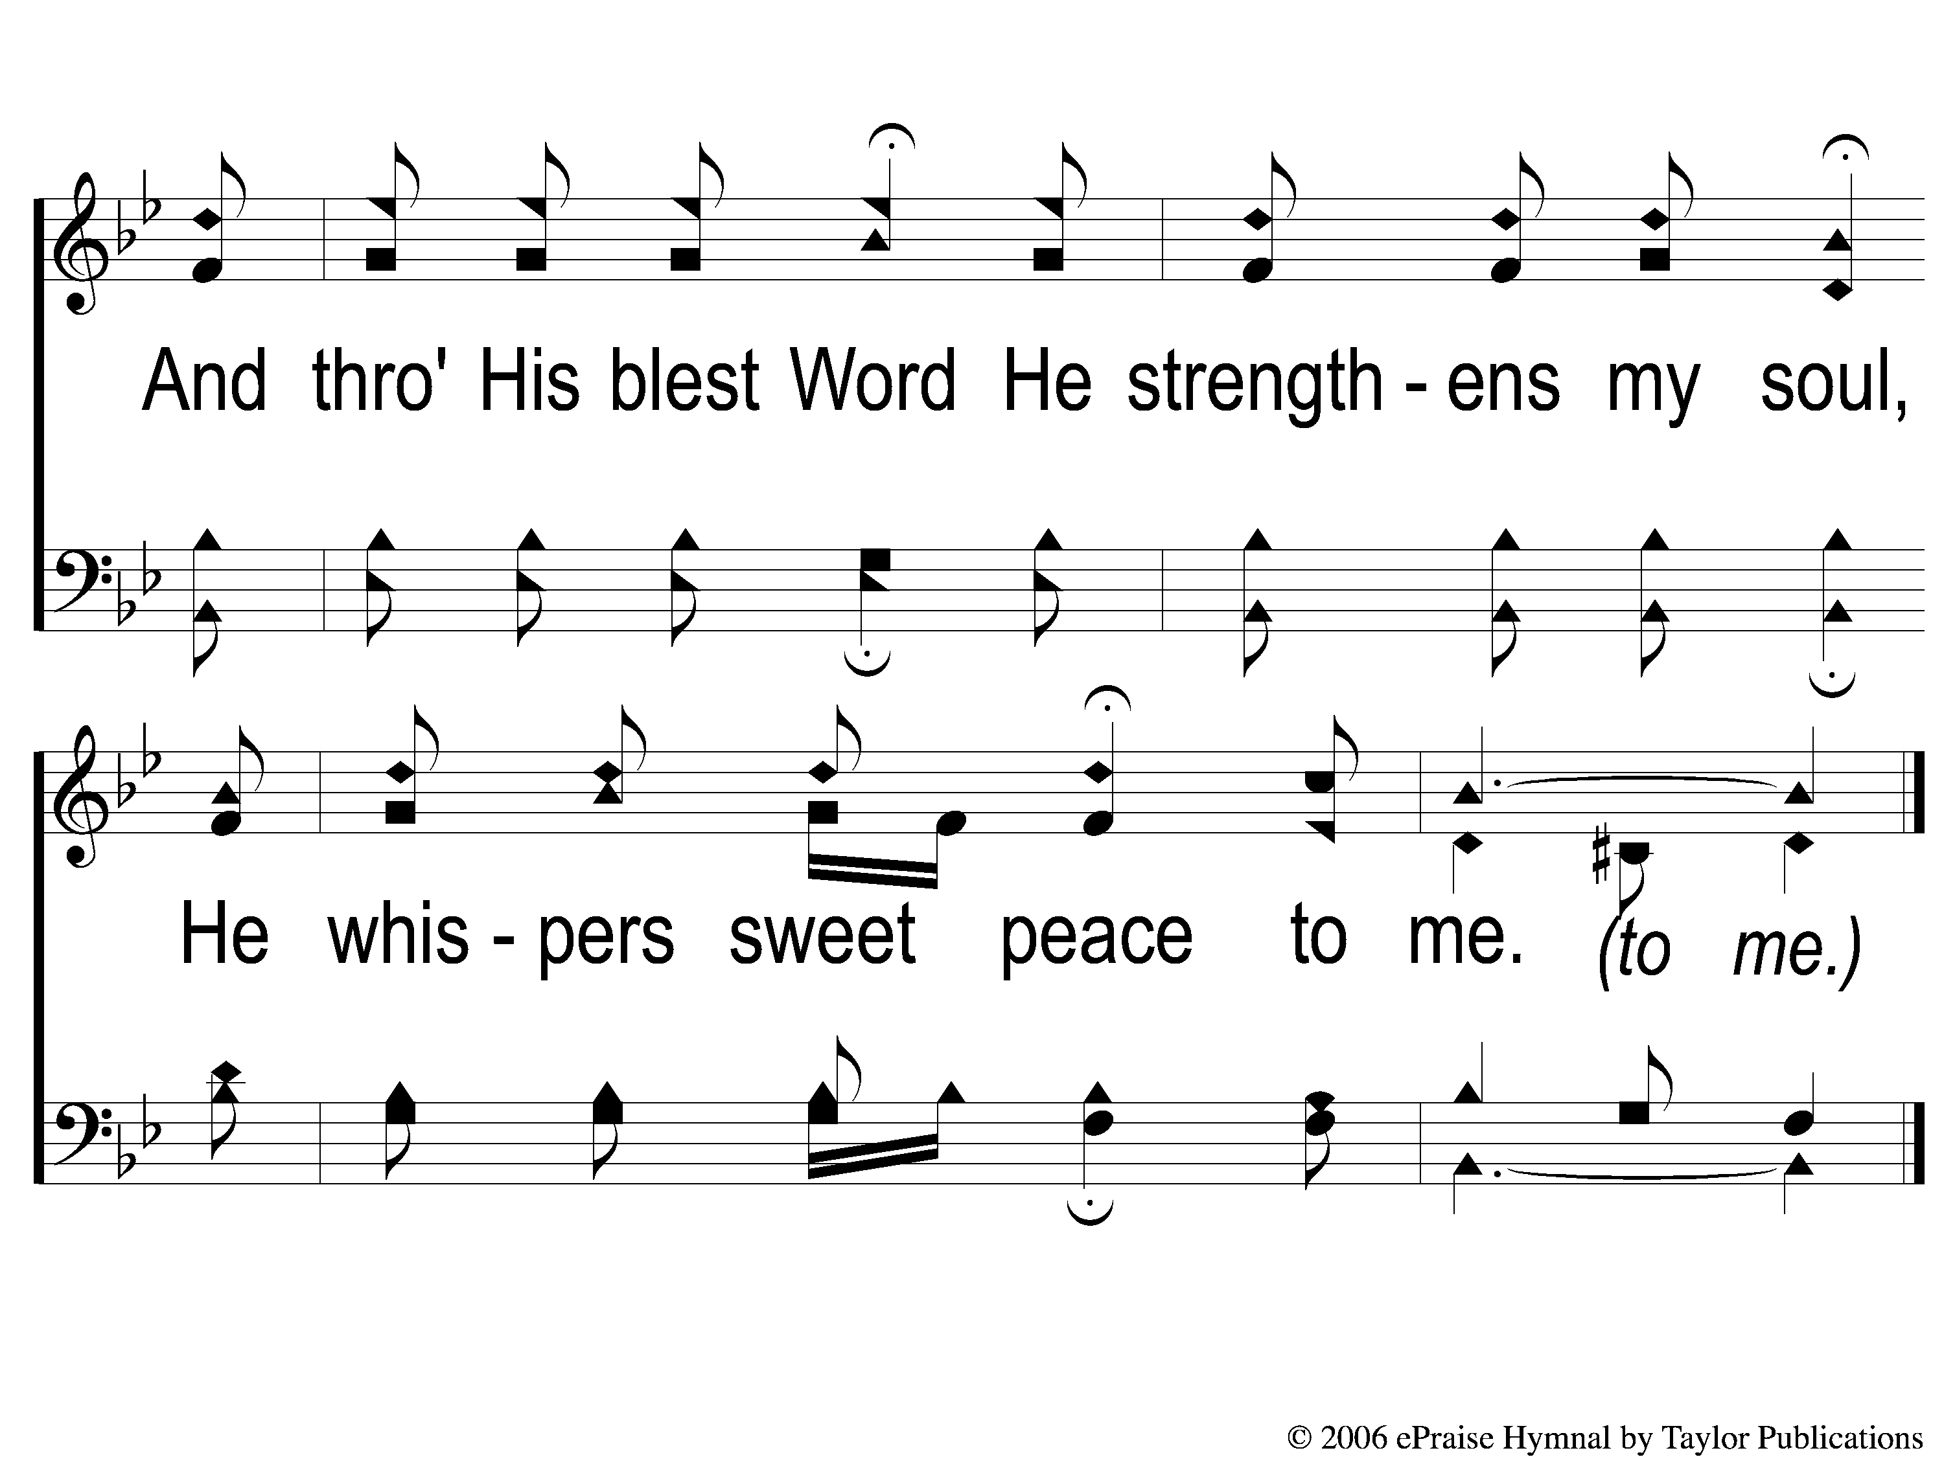
C-2 He Whispers Sweet Peace to Me
He Whispers Sweet Peace To Me
172

Slide 5
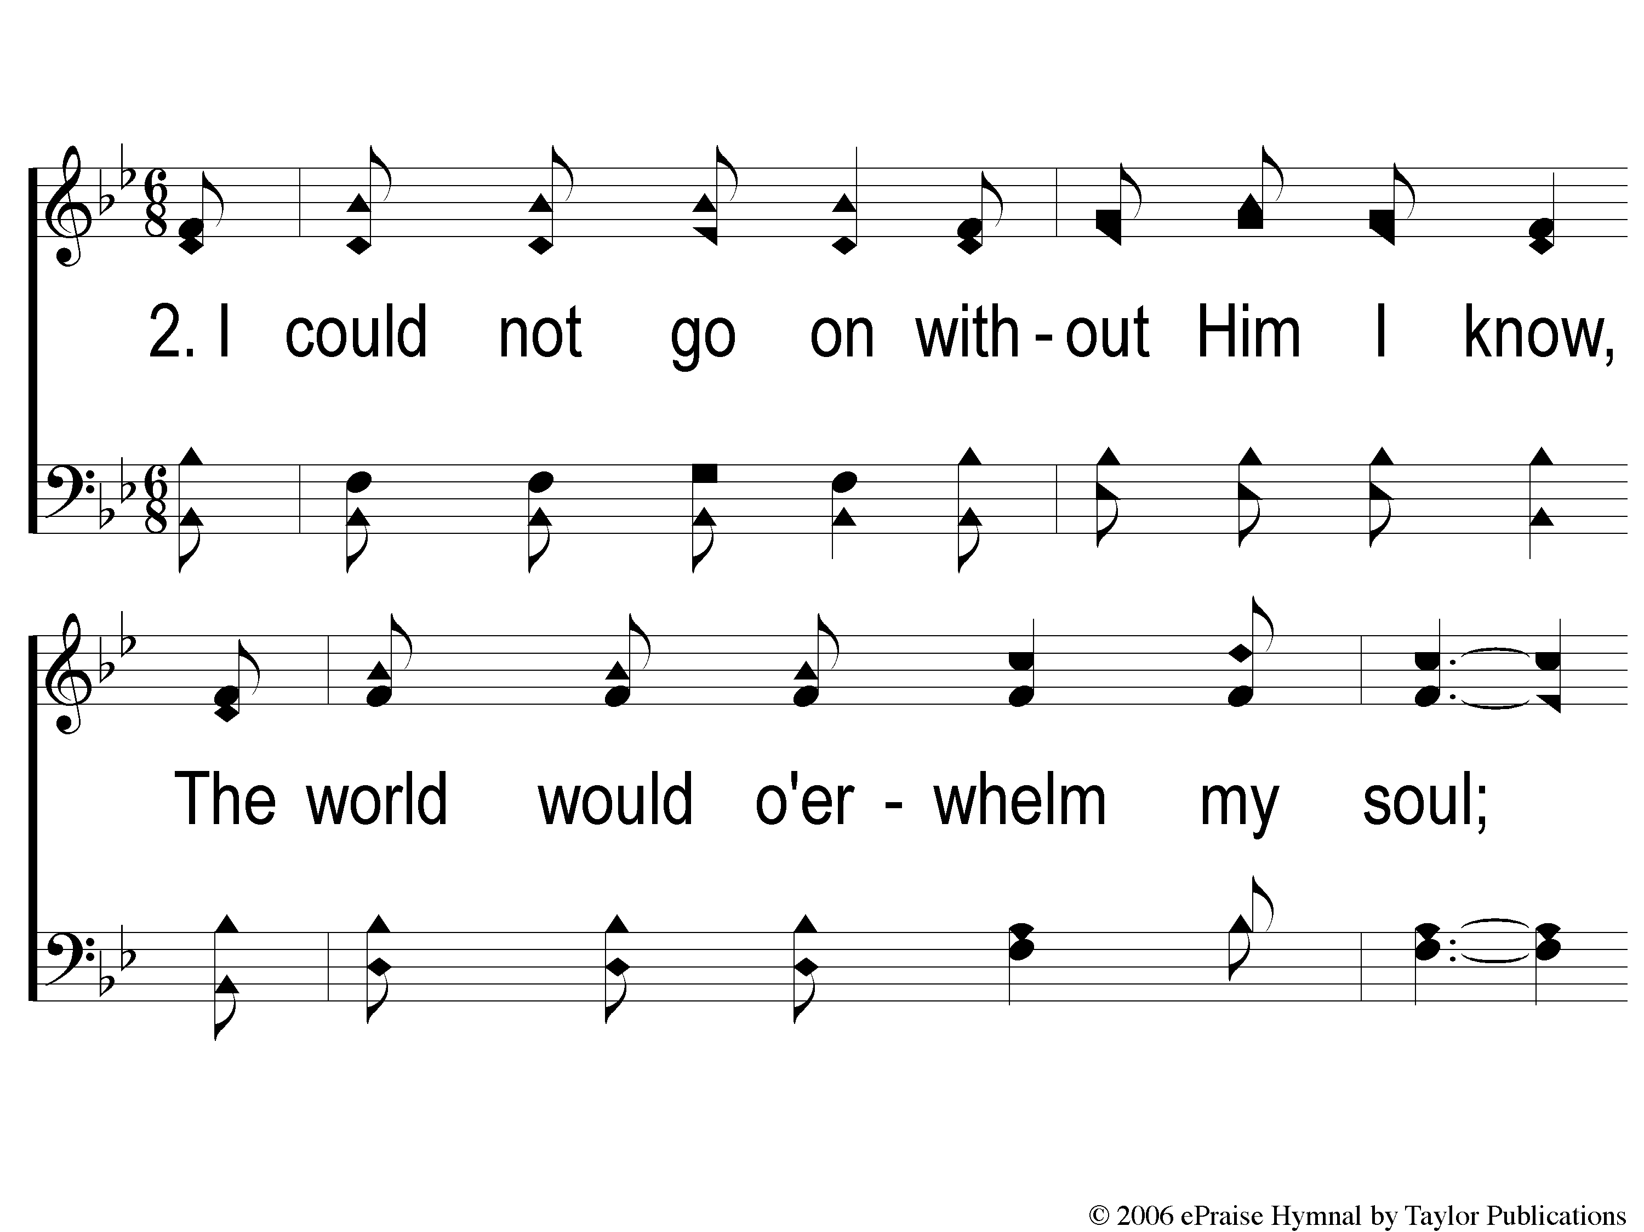
2-1 He Whispers Sweet Peace to Me
He Whispers Sweet Peace To Me
172

Slide 6
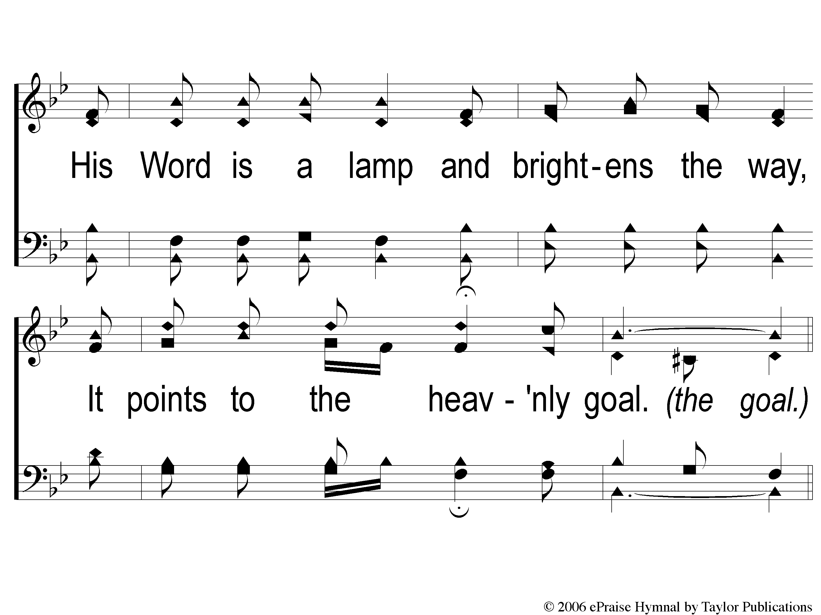
2-2 He Whispers Sweet Peace to Me
He Whispers Sweet Peace To Me
172

Slide 7
C-1 He Whispers Sweet Peace to Me
He Whispers Sweet Peace To Me
172

Slide 8
C-2 He Whispers Sweet Peace to Me
He Whispers Sweet Peace To Me
172

Slide 9
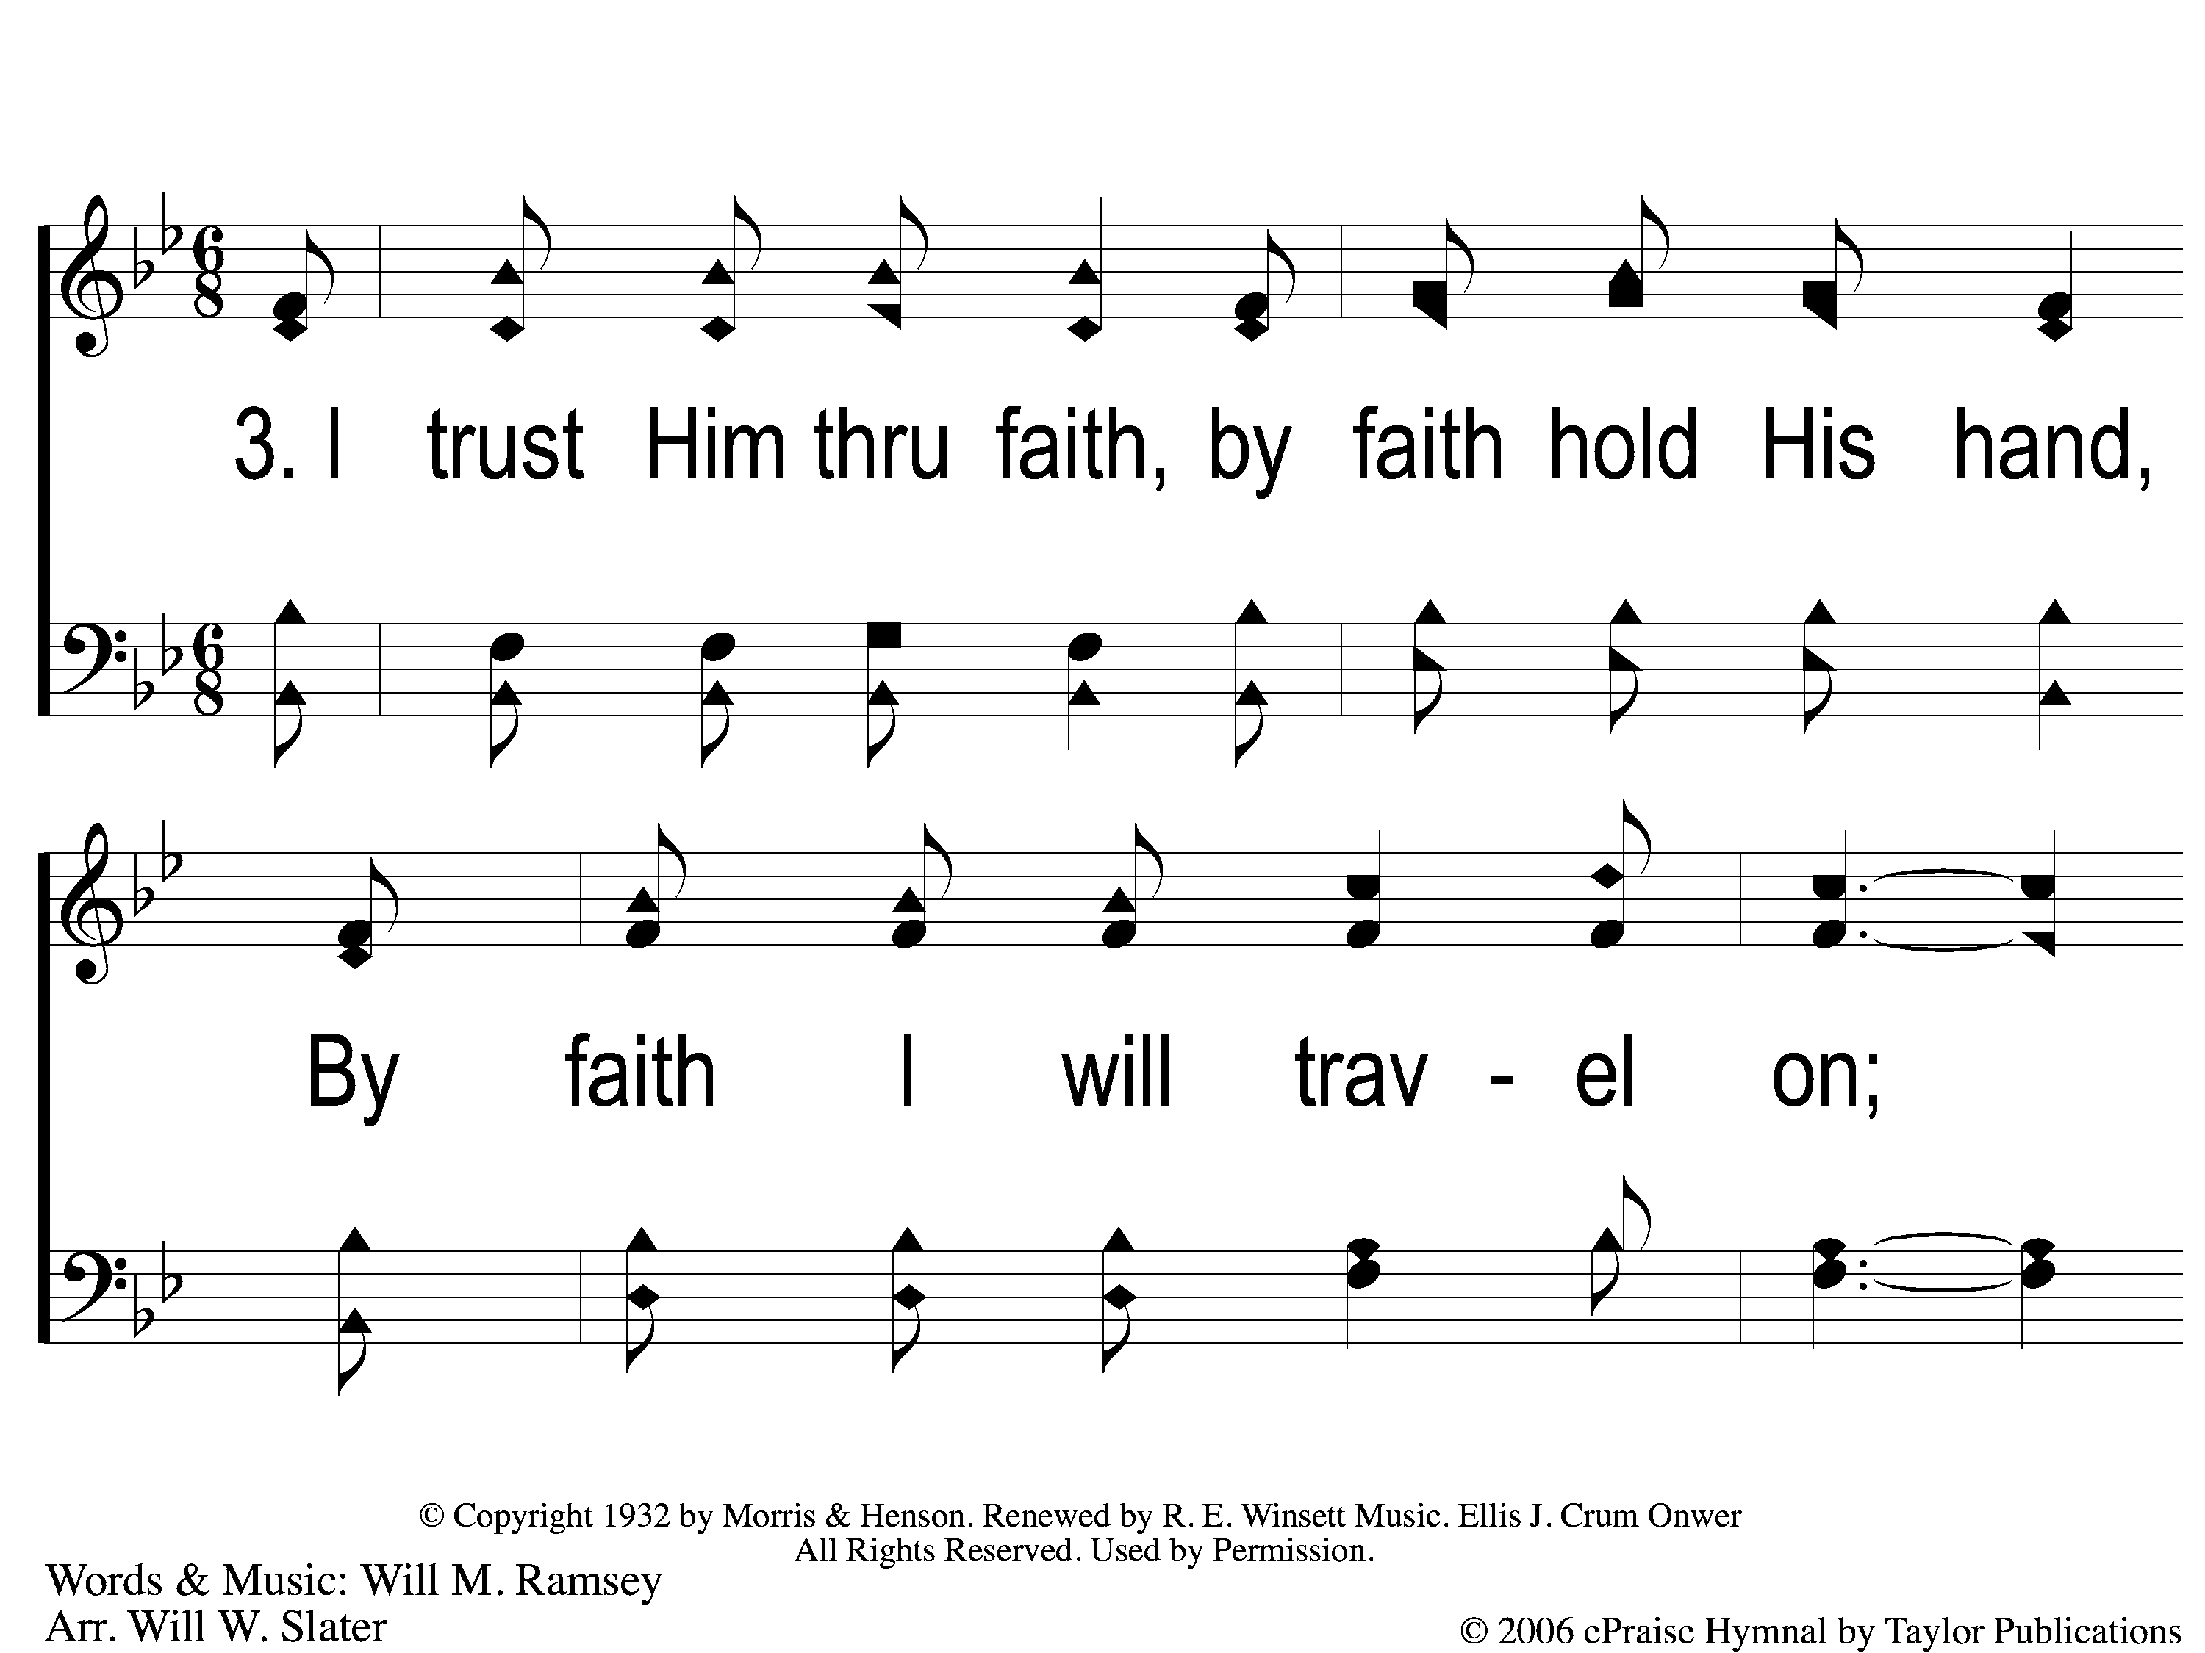
3-1 He Whispers Sweet Peace to Me
He Whispers Sweet Peace To Me
172

Slide 10
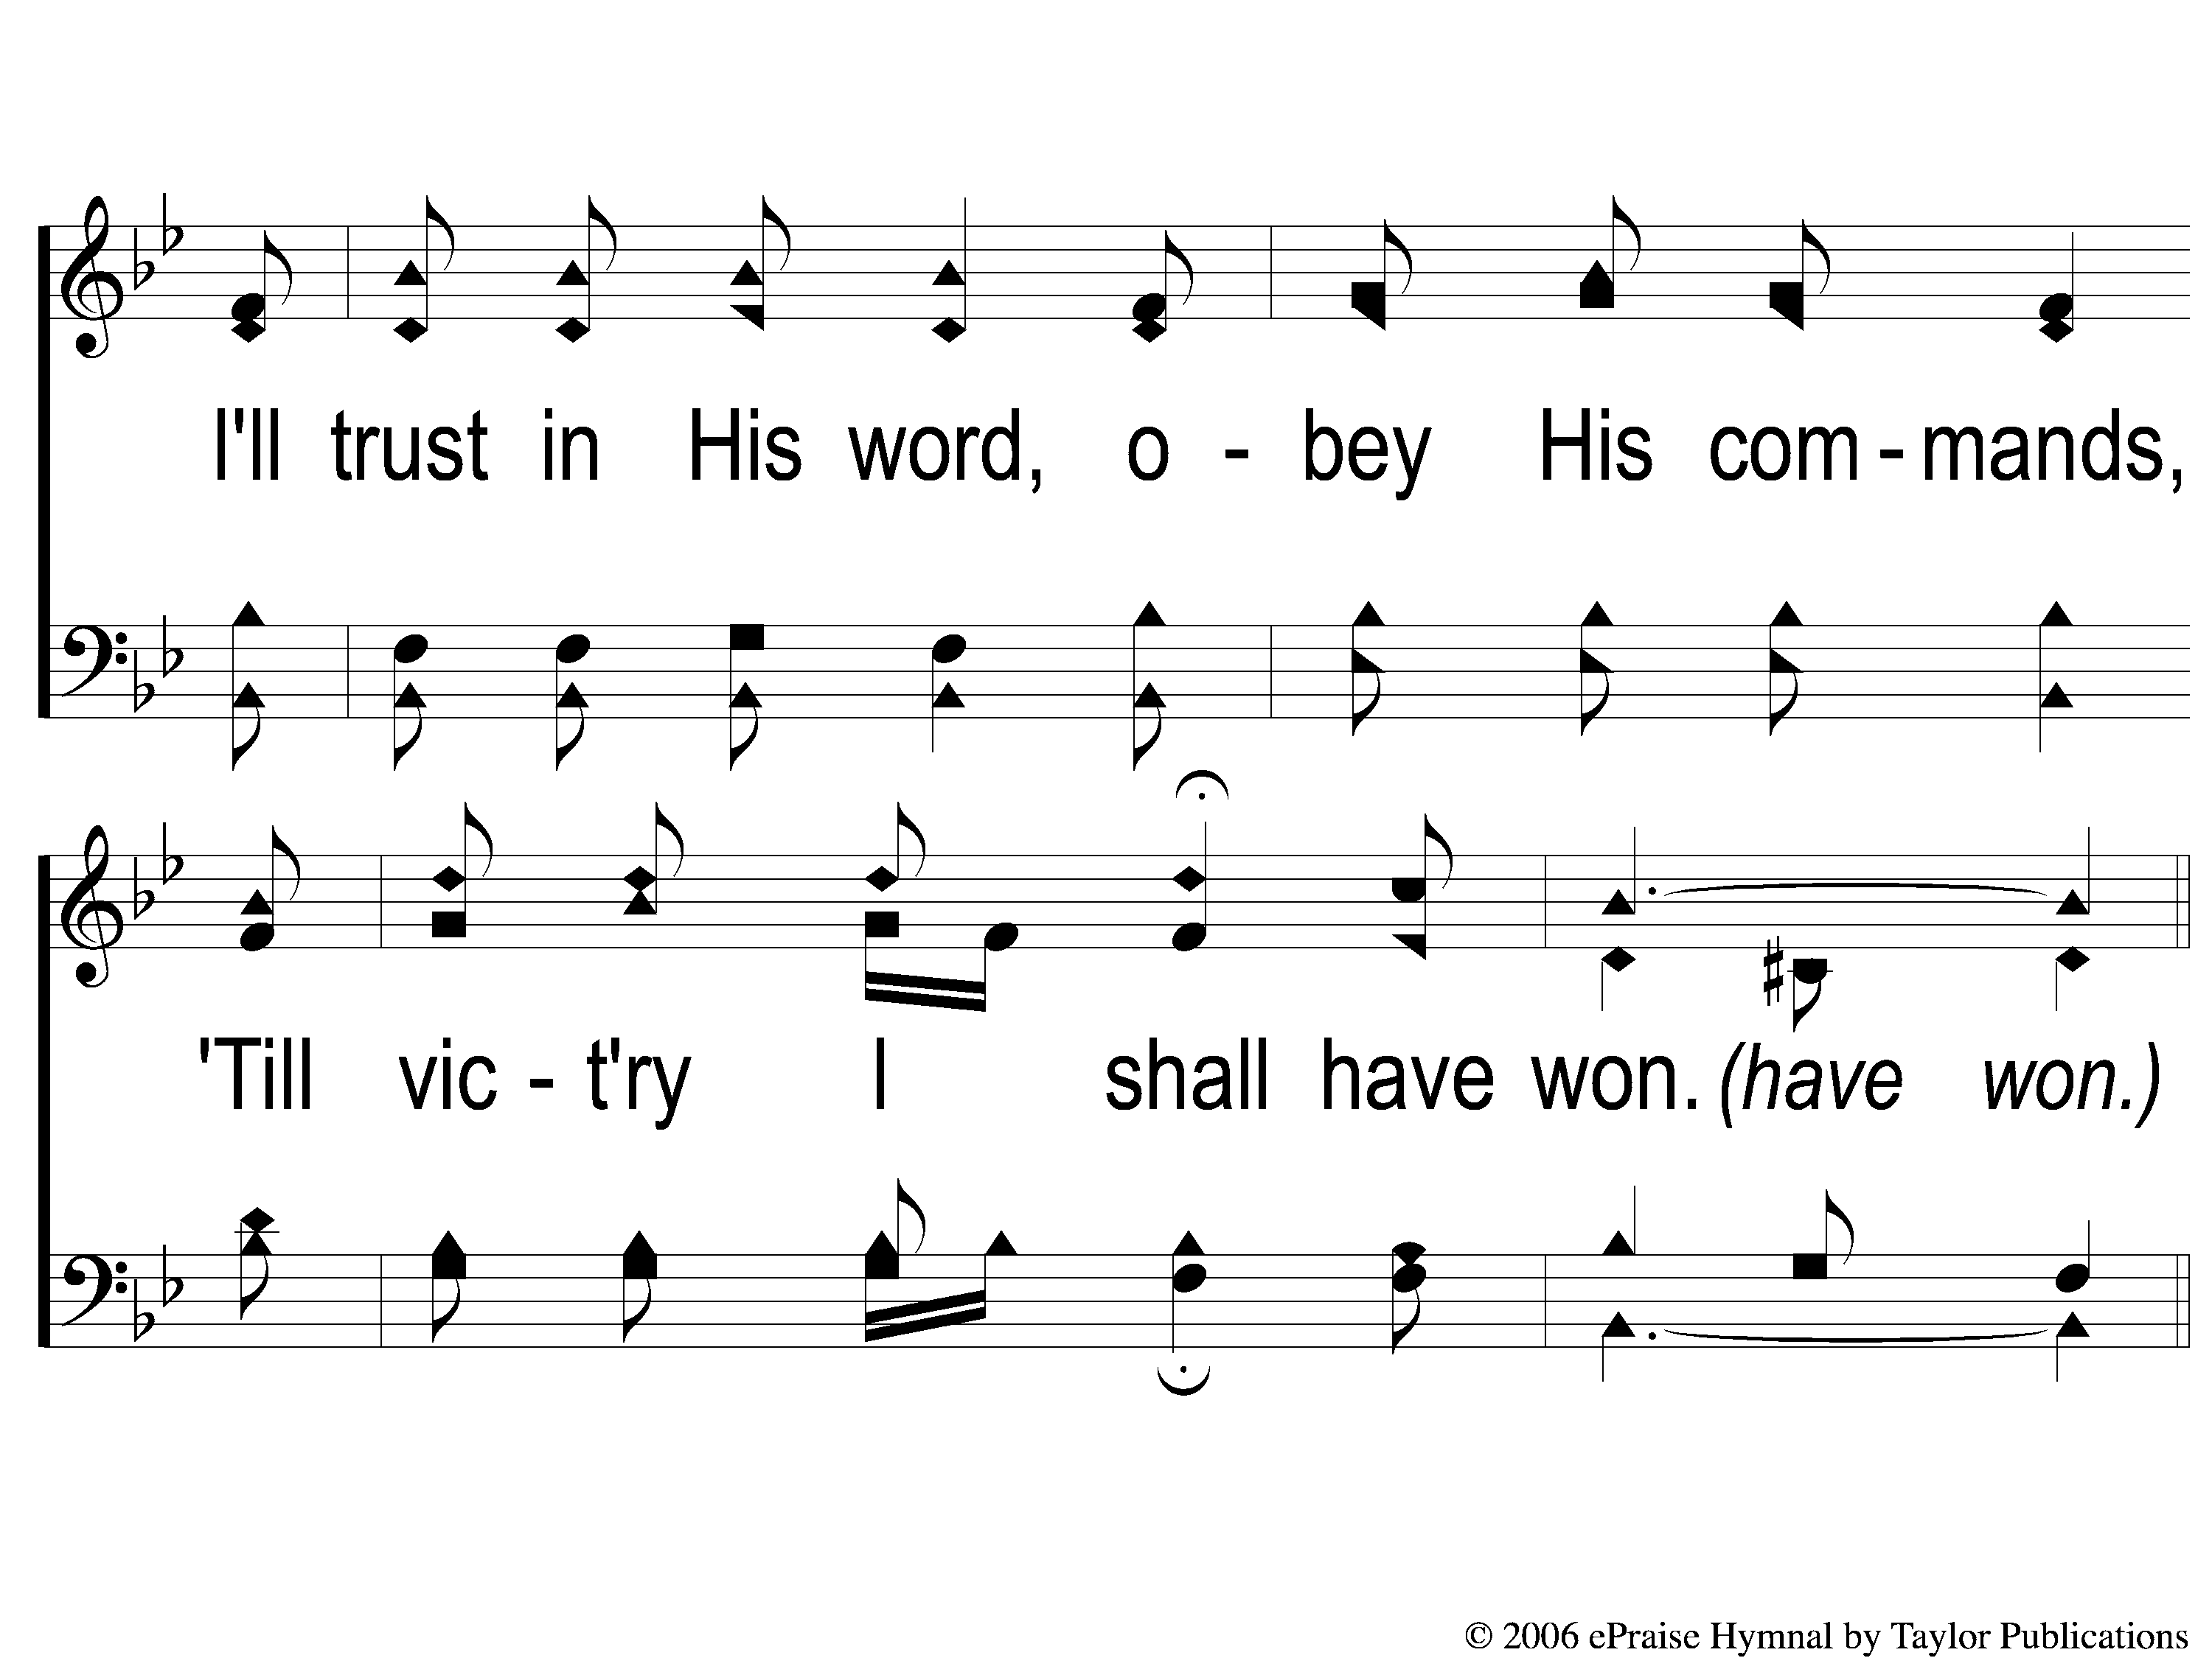
3-2 He Whispers Sweet Peace to Me
He Whispers Sweet Peace To Me
172

Slide 11
C-1 He Whispers Sweet Peace to Me
He Whispers Sweet Peace To Me
172

Slide 12
C-2 He Whispers Sweet Peace to Me
He Whispers Sweet Peace To Me
172

Slide 13
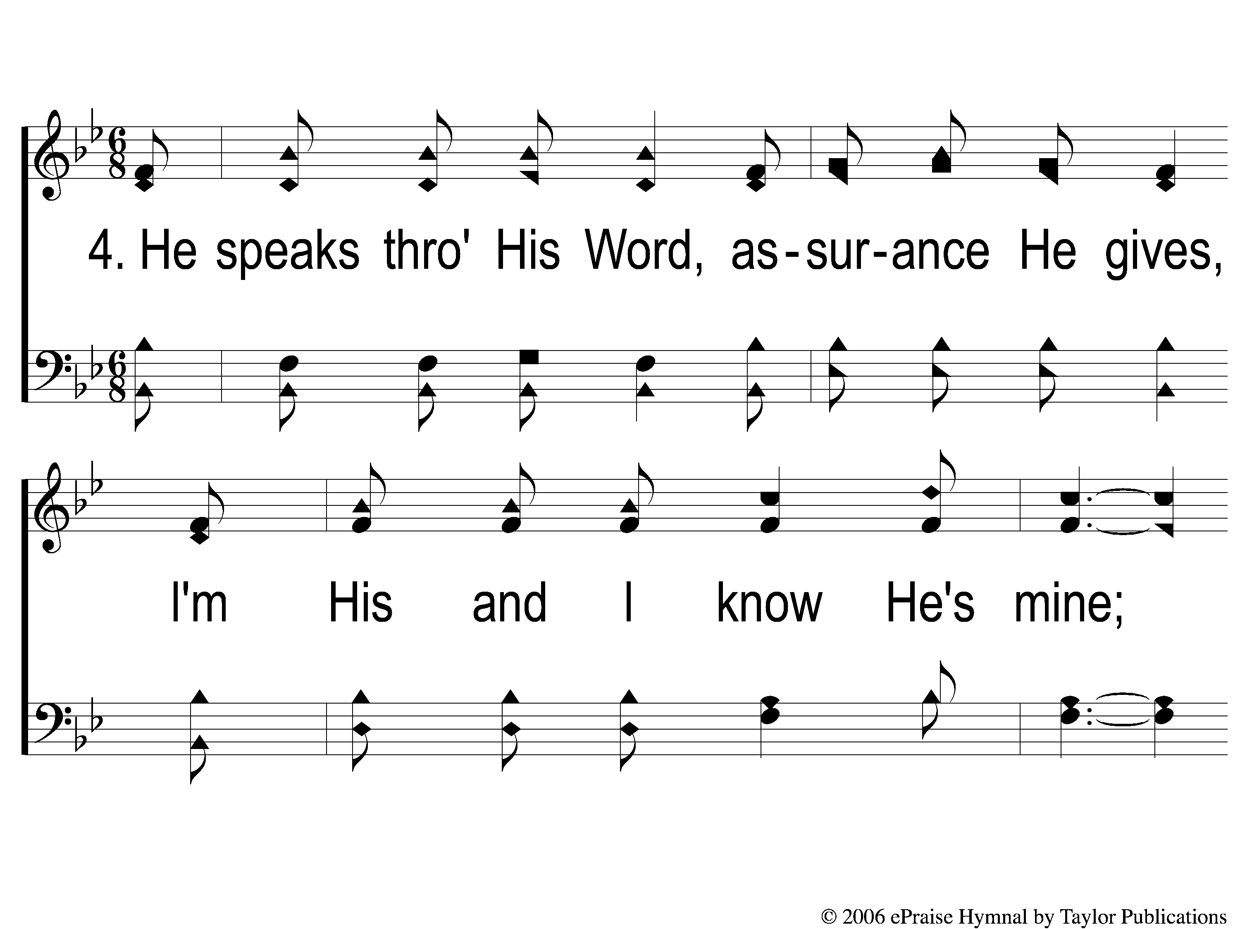
4-1 He Whispers Sweet Peace to Me
He Whispers Sweet Peace To Me
172

Slide 14
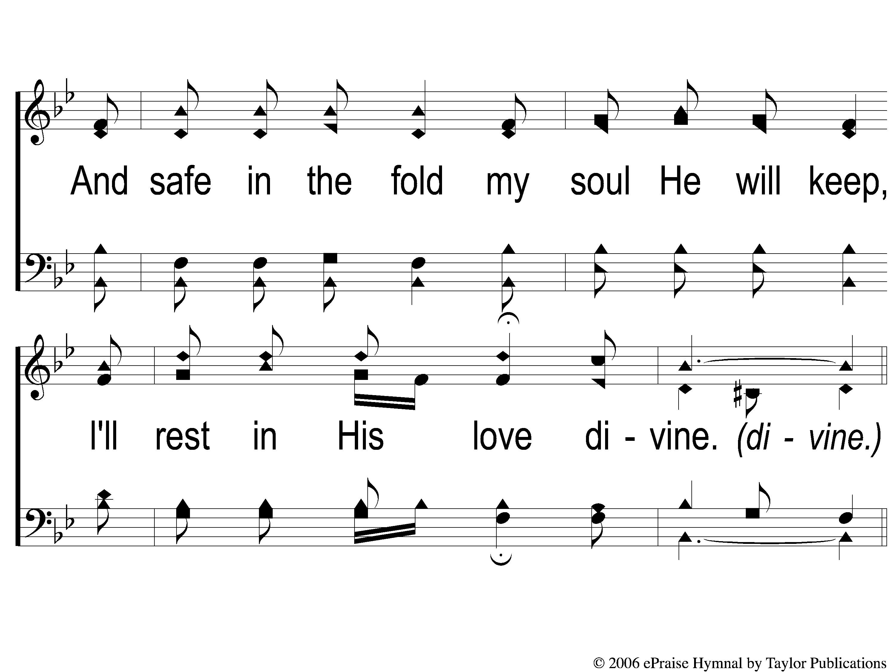
4-2 He Whispers Sweet Peace to Me
He Whispers Sweet Peace To Me
172

Slide 15
C-1 He Whispers Sweet Peace to Me
He Whispers Sweet Peace To Me
172

Slide 16
C-2 He Whispers Sweet Peace to Me
He Whispers Sweet Peace To Me
172

